Slide 1

Module 7: Object-Oriented Detailed Design
Software Engineering
School of Computing, Faculty of Engineering
Universiti Teknologi Malaysia

Slide 2
Objectives
To understand the relationship among analysis, design and implementation
To comprehend object-oriented design principles
To further understand object-oriented design using UML
To elaborate the related diagrams from analysis in design phase in use case realization
References: Sommerville (2016), Arlow and Neustadt (2002), Satzinger (2011)

Slide 3
Relationships among analysis, design and implementation
Objective 1:

Slide 4
Design and Implementation
Software design and implementation is the stage in the software engineering process at which an executable software system is developed
Software design and implementation activities are invariably inter-leaved:
  Software design is a creative activity that identifies software components and their relationships, based on a customer’s requirements
  Implementation is the process of realizing the design as a program

Slide 5
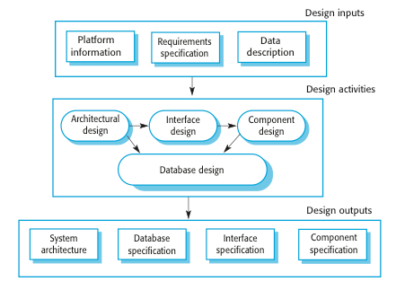
Recap on Design Stage

Slide 6
Object-Oriented Design Process
Structured object-oriented design processes involve developing a number of different system models
They require a lot of effort for development and maintenance of these models and, for small systems, this may not be cost-effective
However, for large systems developed by different groups, design models are an important communication mechanism

Slide 7
Object-oriented design principles
Objective 2:

Slide 8
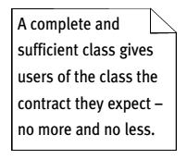
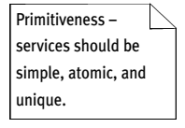
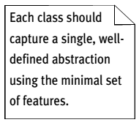
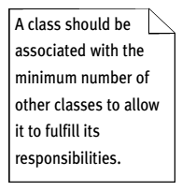
Well-Formed Design Class
Four minimal characteristics that a design class must have to be considered well-formed:
  complete and sufficient
  primitive
  high cohesion
  low coupling
Source: Arlow and Neustadt (2002)

Slide 9
Some Fundamental Design Principles…
Encapsulation
  Each object is a self-contained unit containing both data and program logic
Object reuse
  Standard objects can be used over and over again within a system
Information hiding
  Data associated with an object is not visible
  Methods provide access to data

Slide 10
Some Fundamental Design Principles
Navigation visibility
  Describes which objects can interact with each other
Coupling
  Measures how closely classes are linked
Cohesion
  Measures the consistency of functions in a class
Separation of responsibilities
  Divides a class into several highly cohesive classes

Slide 11
Coupling and Cohesion of Subsystems
Good Design
Goal: Reduce system complexity while allowing change
Coherence measures dependency among classes
  High cohesion: The classes in the subsystem perform similar tasks and are related to each other via associations
  Low cohesion: Lots of miscellaneous and auxiliary classes, no associations
Coupling measures dependency among subsystems
  High coupling: Changes to one subsystem will have high impact on the other subsystem
  Low coupling: A change in one subsystem does not affect any other subsystem
Source: Bennett et al. (2010)

Slide 12
How to Achieve High Cohesion
High cohesion can be achieved if most of the interaction is within subsystems, rather than across subsystem boundaries
Questions to ask:
  Does one subsystem always call another one for a specific service?
    Yes: Consider moving them together into the same subystem
  Which of the subsystems call each other for services?
    Can this be avoided by restructuring the subsystems or changing the subsystem interface?
Notes:
What kind of model is good for describing layers and partitions? UML Class diagrams!

Slide 13

How to Achieve Low Coupling
Low coupling can be achieved if a calling class or interface does not need to know anything about the internals of the called class (Principle of information hiding, Parnas)
Questions to ask:
  Does the calling class really have to know any attributes of classes in the lower layers?
  Is it possible that the calling class calls only operations of the lower level classes?
David Parnas, *1941,
Developed the concept of
modularity in design
Notes:
What kind of model is good for describing layers and partitions? UML Class diagrams!

